Slide 1
Kaggle Competition
Home Credit Project
By Dick SANG

Slide 2
What was about the competition?
Background:
https://www.kaggle.com/c/home-credit-default-risk
To predict that if a credit event occurs

Slide 3
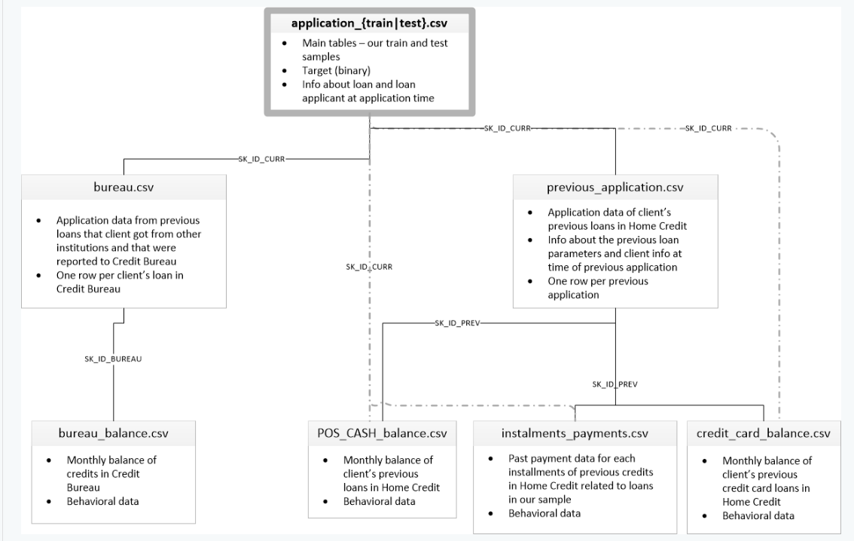
Data source and its structure

Slide 4
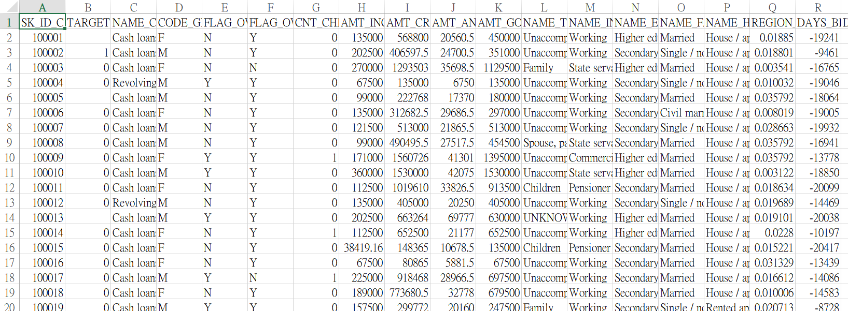
Data preparation and feature engineering (SAS)

Slide 5
Methods employed (R)
Logistic regression
Extreme Gradient Boosting (XGB)
Deep learning
LGBM

Slide 6
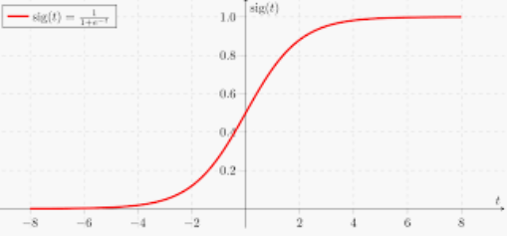
Logistic regression
2 class logistic regression model the probability of a binary / 2 classes/ event.

Slide 7
Extreme Gradient Boosting (1)
Gradient boosting is a machine learning technique for regression and classification problems, which produces a prediction model in the form of an ensemble of weak prediction models, typically decision trees. (by aggregating the output from many models) – weak models added together
Random Forest uses fully grown decision trees to reduce variances.

Slide 8
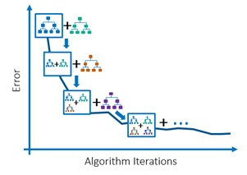
Extreme Gradient Boosting (2)

Slide 9
Deep learning (1)
Deep learning (also known as deep structured learning or hierarchical learning) is part of a broader family of machine learning methods based on artificial neural networks.
There are different kinds of Deep Neural Networks, such as deep neural networks, deep belief networks, recurrent neural networks and convolutional neural networks.

Slide 10
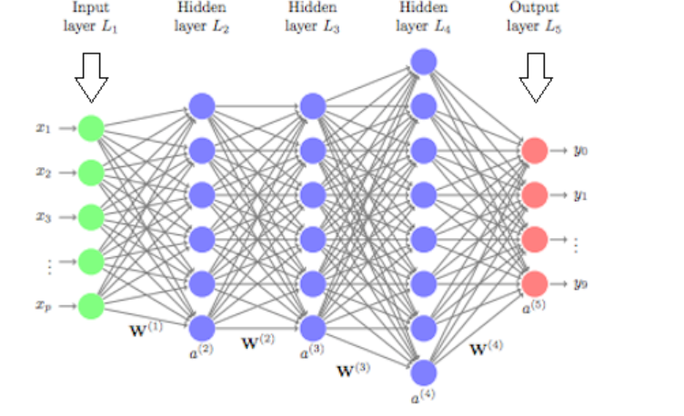
Deep learning (2) – DL and its parameters

Slide 11
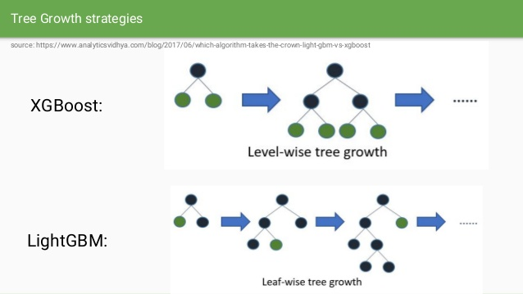
LGBM
LightGBM is a gradient boosting framework that uses tree based learning algorithms. (It grows by leaves instead of levels)

Slide 12
Thank you

